Slide 1
Chapter 11: It’s a Network
Introduction to Networking
Notes:
Cisco Networking Academy program
Introduction to Networking
Chapter 11:

Slide 2
Chapter 11
11.1 Create and Grow
11.2 Keeping the Network Safe
11.3 Basic Network Performance
11.4 Managing IOS Configuration Files
11.5 Integrated Routing Services
11.6 Summary
Notes:
Chapter 11

Slide 3
Chapter 11: Objectives
Identify the devices and protocols used in a small network
Explain how a small network serves as the basis of larger networks.
Explain the need for basic security measures on network devices.
Identify security vulnerabilities and general mitigation techniques

Slide 4
Chapter 11: Objectives (continued)
Use the output of ping and tracert commands to establish relative network performance.
Use basic show commands to verify the configuration and status of a device interface.
Explain the file systems on Routers and Switches.
Apply the commands to back up and restore an IOS configuration file.

Slide 5
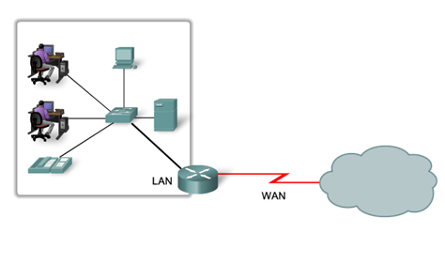
Devices in a Small Network Small Network Topologies
Typical Small Network Topology
Notes:
11.1 Devices in a small network
11.1.1 Small Network Topologies

Slide 6
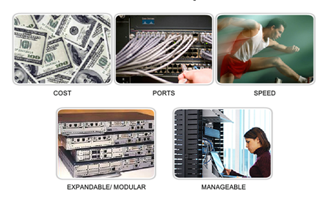
Devices in a Small Network Device Selection for a Small Network
Factors to be considered when selecting intermediate devices
Notes:
11.1.1.2 Device Selection for a Small Network

Slide 7
Devices in a Small Network Addressing for a Small Network
IP addressing scheme should be planned, documented and maintained based on the type of devices receiving the address.
Examples of devices that will be part of the IP design:
End devices for users
Servers and peripherals
Hosts that are accessible from the Internet
Intermediary devices
Planned IP schemes help the administrator:
Track devices and troubleshoot
Control access to resources
Notes:
11.1.1.3 Addressing for a Small Network

Slide 8
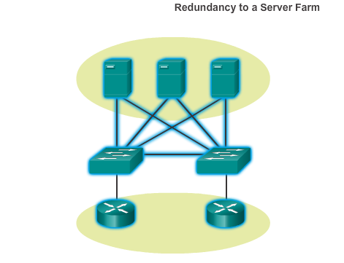
Devices in a Small Network Redundancy in a Small Network
Redundancy helps to eliminate single points of failure.
Improves the reliability of the network.
Notes:
11.1.1.4 Redundancy in a Small Network

Slide 9
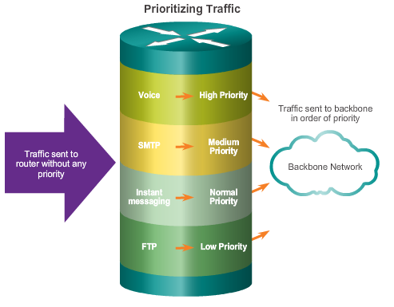
Devices in a Small Network Design Considerations for a Small Network
The following should be included in the network design:
Secure file and mail servers in a centralized location.
Protect the location by physical and logical security measures.
Create redundancy in the server farm.
Configure redundant paths to the servers.
Notes:
11.1.1.5 Design Considerations for a Small Network

Slide 10
Protocols in a Small Network Common Applications in a Small Network
Network-Aware Applications - software programs used to communicate over the network.
Application Layer Services - programs that interface with the network and prepare the data for transfer.
Notes:
11.1.2 Protocols in a Small Network
11.1.2.1 Common Applications in a Small Network

Slide 11
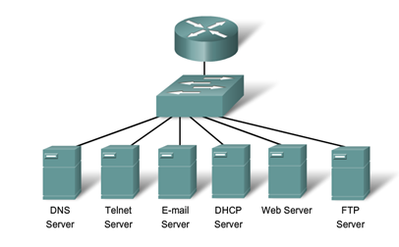
Protocols in a Small Network Common Protocols in a Small Network
Network Protocols Define:
Processes on either end of a communication session
Types of messages
Syntax of the messages
Meaning of informational fields
How messages are sent and the expected response
Interaction with the next lower layer
Notes:
11 .1.2.2 Common Protocols in a Small Network

Slide 12
Protocols in a Small Network Real-Time Applications for a Small Network
Infrastructure - needs to be evaluated to ensure it will support proposed real time applications.
VoIP is implemented in organizations that still use traditional telephones
IP telephony - the IP phone itself performs voice-to-IP conversion
Real-time Video Protocols - Use Time Transport Protocol (RTP) and Real-Time Transport Control Protocol (RTCP)
Notes:
11.1.2.3 Real-Time Applications for a Small Network

Slide 13
Growing to Larger Networks Scaling a Small Network
Important considerations when growing to a larger network:
Documentation – physical and logical topology
Device inventory – list of devices that use or comprise the network
Budget – itemized IT budget, including fiscal year equipment purchasing budget
Traffic Analysis – protocols, applications, and services and their respective traffic requirements should be documented
Notes:
11.1.3 Growing to Larger Networks
11.1.3.1 Scaling a Small Network

Slide 14
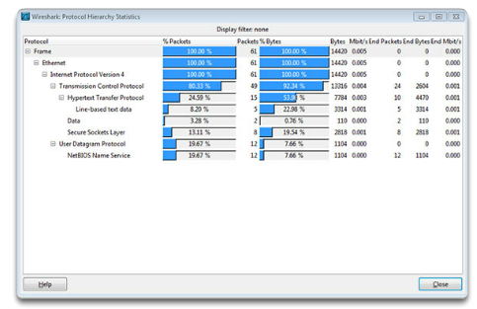
Growing to Larger Networks Protocol Analysis of a Small Network
Information gathered by protocol analysis can be used to make decisions on how to manage traffic more efficiently.
Notes:
11.1.3.2 Protocol Analysis of a Small Network

Slide 15
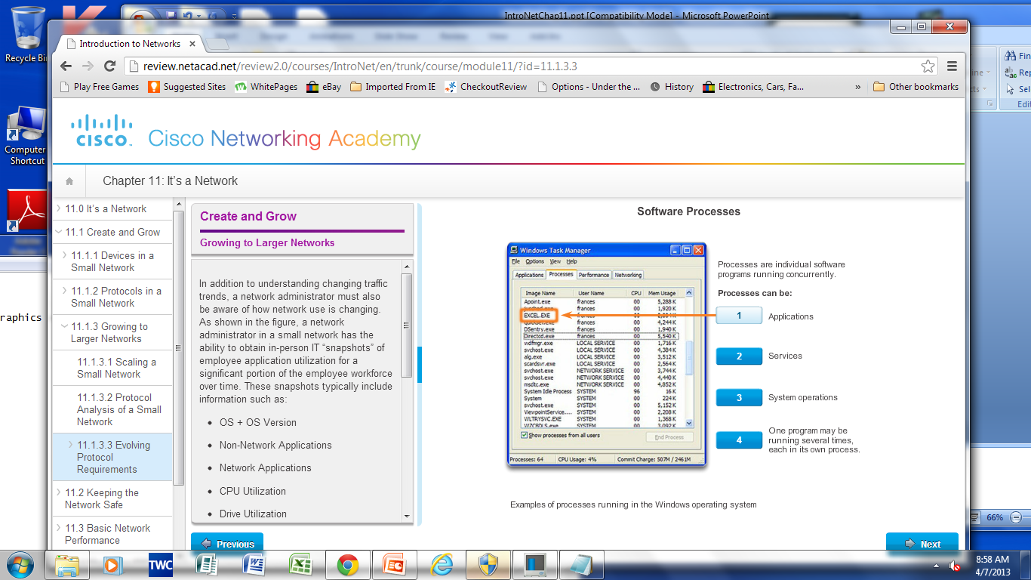
Growing to Larger Networks Evolving Protocol Requirements
Network administrator can obtain IT “snapshots” of employee application utilization.
Snapshots track network utilization and traffic flow requirements.
Snapshots help inform network modifications needed.
Notes:
11.1.3.3 Evolving Protocol Requirements

Slide 16
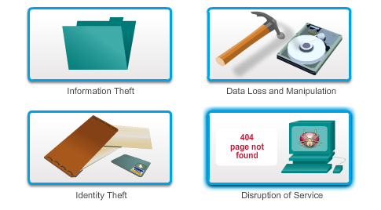
Network Device Security Measures Threats to Network Security
Categories of Threats to Network Security
Notes:
11.2 Keeping the Network Safe
11.2.1 Network Device Security Measures
11.2.1.1 Categories of Threats to Network Security

Slide 17
Network Device Security Measures Physical Security
Four classes of physical threats are:
Hardware threats - physical damage to servers, routers, switches, cabling plant, and workstations.
Environmental threats - temperature extremes (too hot or too cold) or humidity extremes (too wet or too dry)
Electrical threats - voltage spikes, insufficient supply voltage (brownouts), unconditioned power (noise), and total power loss
Maintenance threats - poor handling of key electrical components (electrostatic discharge), lack of critical spare parts, poor cabling, and poor labeling
Notes:
11.2.1.2 Physical Security

Slide 18
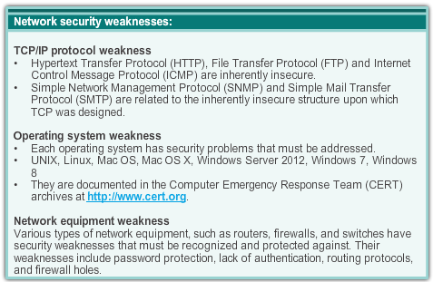
Network Device Security Measures Types of Security Vulnerabilities
Technological weaknesses
Configuration weaknesses
Security policy weaknesses
Notes:
11.2.1.3 Types of Security Vulnerabilities

Slide 19
Vulnerabilities and Network Attacks Viruses, Worms and Trojan Horses
A virus - malicious software that is attached to another program to execute a particular unwanted function on a workstation.
A Trojan horse - the entire application was written to look like something else, when in fact it is an attack tool.
Worms - self-contained programs that attack a system and try to exploit a specific vulnerability in the target. The worm copies its program from the attacking host to the newly exploited system to begin the cycle again.
Notes:
11.2.2 Vulnerabilities and Network Attacks
11.2.2.1 Viruses, Worms and Trojan Horses

Slide 20
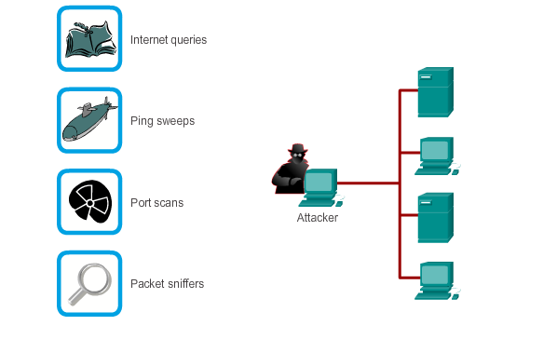
Vulnerabilities and Network Attacks Reconnaissance Attacks
Notes:
11.2.2.2 Reconnaissance, Access and DoS Attacks

Slide 21
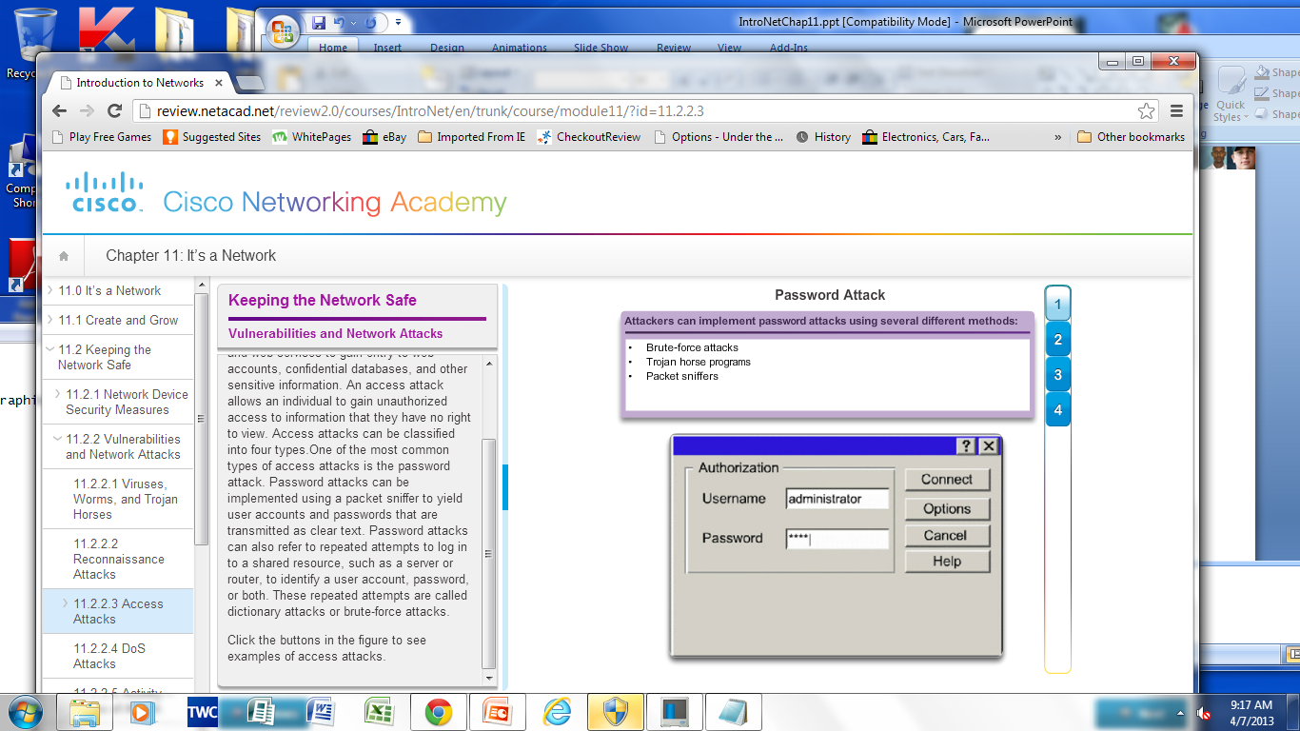
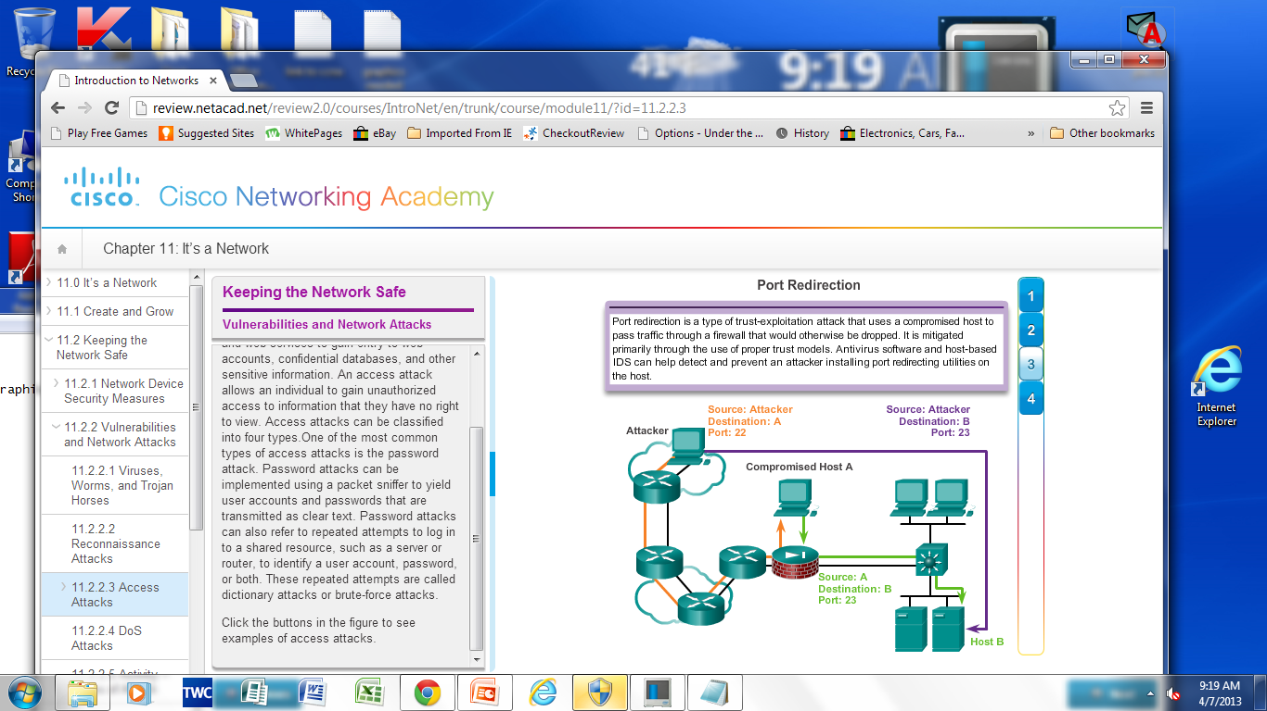
Vulnerabilities and Network Attacks Access Attacks
Notes:
11.2.2.3 Access Attacks

Slide 22
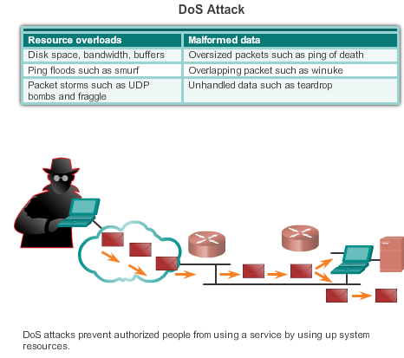
Vulnerabilities and Network Attacks Denial of Service Attacks (DoS)
Notes:
11.2.2.4 DoS Attacks

Slide 23
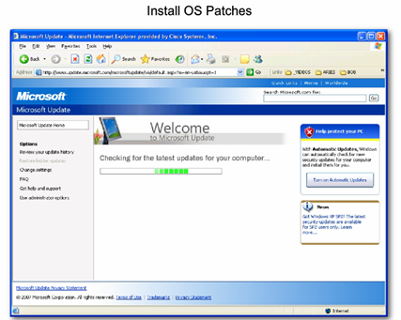
Mitigating Network Attacks Backup, Upgrade, Update, and Patch
Keep current with the latest versions of antivirus software.
Install updated security patches
Notes:
11.2.3 Mitigating Network Attacks
11.2.3.1 Backup, Upgrade, Update, and Patch

Slide 24
Mitigating Network Attacks Authentication, Authorization, and Accounting
Authentication, Authorization, and Accounting (AAA, or “triple A”)
Authentication - Users and administrators must prove their identity. Authentication can be established using username and password combinations, challenge and response questions, token cards, and other methods.
Authorization - which resources the user can access and which operations the user is allowed to perform.
Accounting - records what the user accessed, the amount of time the resource is accessed, and any changes made.
Notes:
11.2.3.2 Authentication, Authorization, and Accounting

Slide 25
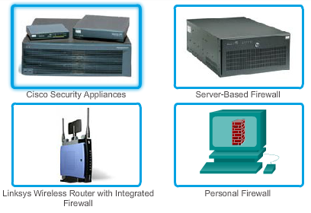
Mitigating Network Attacks Firewalls
A firewall resides between two or more networks. It controls traffic and helps prevent unauthorized access. Methods used are:
Packet Filtering
Application Filtering
URL Filtering
Stateful Packet Inspection (SPI) - Incoming packets must be legitimate responses to requests from internal hosts.
Notes:
11.2.3.3 Firewalls

Slide 26
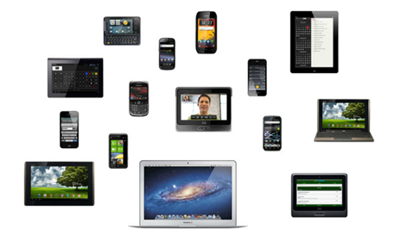
Mitigating Network Attacks Endpoint Security
Common endpoints are laptops, desktops, servers, smart phones, and tablets.
Employees must follow the companies documented security policies to secure their devices.
Policies often include the use of anti-virus software and host intrusion prevention.
Notes:
11.2.3.4 Endpoint Security

Slide 27
Securing Devices Introduction to Securing Devices
Part of network security is securing devices, including end devices and intermediate devices.
Default usernames and passwords should be changed immediately.
Access to system resources should be restricted to only the individuals that are authorized to use those resources.
Any unnecessary services and applications should be turned off and uninstalled, when possible.
Update with security patches as they become available.
Notes:
11.2.4 Securing Devices
11.2.4.1 Introduction to Securing Devices

Slide 28
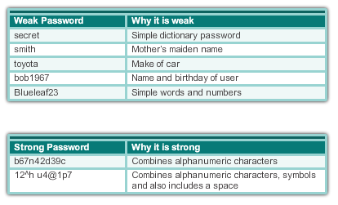
Securing Devices Passwords
Notes:
11.2.4 Securing Devices
11.2.4.2 Passwords

Slide 29
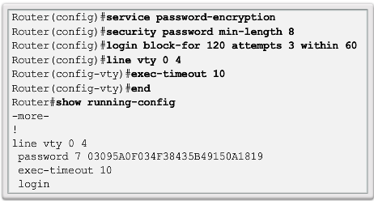
Securing Devices Basic Security Practices
Encrypt passwords
Require minimum length passwords
Block brute force attacks
Use Banner Message
Set EXEC timeout
Notes:
11.2.4 Securing Devices
11.2.4.3 Basic Security Practices

Slide 30
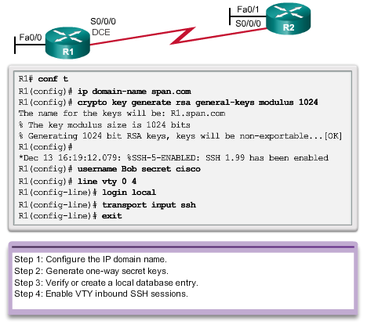
Securing Devices Enable SSH
Notes:
11.2.4 Securing Devices
11.2.4.4 Enable SSH

Slide 31
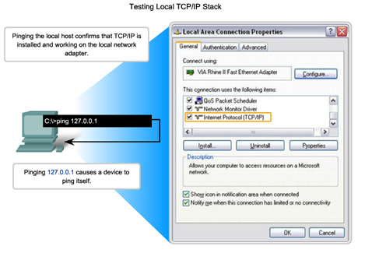
Ping Interpreting ICMP Messages
! - indicates receipt of an ICMP echo reply message
. - indicates a time expired while waiting for an ICMP echo reply message
U - an ICMP unreachable message was received
Notes:
11.3 Basic Network Performance
11.3.1 Ping
11.3.1.1 Interpreting ICMP Messages

Slide 32
Ping Leveraging Extended Ping
The Cisco IOS offers an "extended" mode of the ping command
R2# ping
Protocol [ip]:
Target IP address: 192.168.10.1
Repeat count [5]:
Datagram size [100]:
Timeout in seconds [2]:
Extended commands [n]: y
Source address or interface: 10.1.1.1
Type of service [0]:
Notes:
11.3.1.2 Leveraging Extended Ping

Slide 33
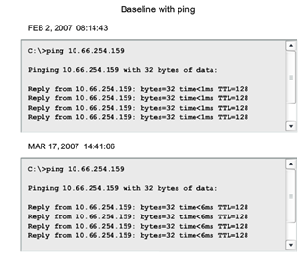
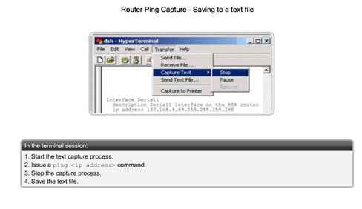
Ping Network Baseline
Notes:
11.3.1. 3 Network Baseline

Slide 34
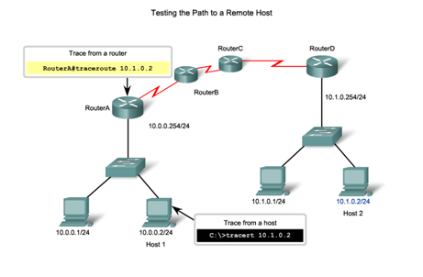
Tracert Interpreting Tracert Messages
Notes:
11.3.2 Tracert
11.3.2.1 Interpreting Tracert Messages

Slide 35
Show Commands Common Show Commands Revisited
The status of nearly every process or function of the router can be displayed using a show command.
Frequently used show commands:
show running-config
show interfaces
show arp
show ip route
show protocols
show version
Notes:
11.3.3 Show Commands
11.3.3.1 Common Show Commands Revisited

Slide 36
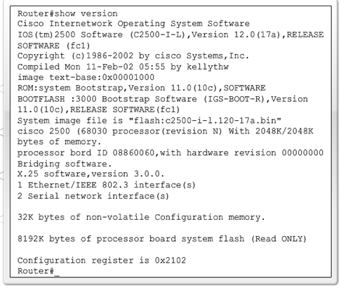
Show Commands Viewing Router Settings with Show Version
Cisco IOS version
System bootstrap
Cisco IOS image
CPU and RAM
Number and type of physical interfaces
Amount of NVRAM
Amount of Flash
Config. register
Notes:
11.3.3.2 Viewing Router Settings with the Show Version Command

Slide 37
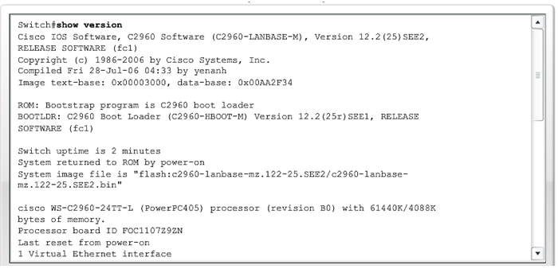
Show Commands Viewing Switch Settings with Show Version
Notes:
11.3.3.3 Viewing Switch Settings with Show Version

Slide 38
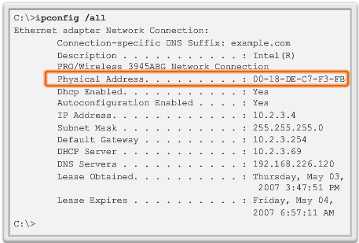
Host and IOS Commands ipconfig Command Options
ipconfig - displays ip address, subnet mask, default gateway.
ipconfig /all – also displays MAC address.
Ipconfig /displaydns - displays all cached dns entries in a Windows system .
Notes:
11.3.4 Host and IOS Commands
11.3.3.1 ipconfig Command Options

Slide 39
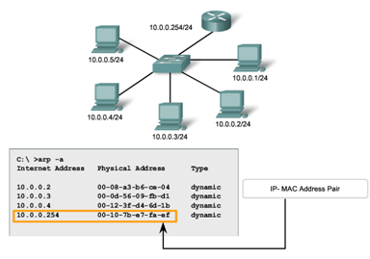
Host and IOS Commands arp Command Options
Notes:
11.3.4.2 arp Command Options

Slide 40
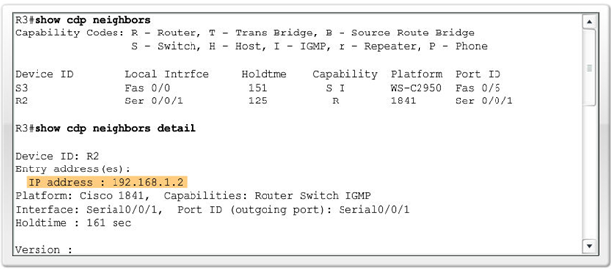
Host and IOS Commands show cdp neighbors Command Options
Notes:
11.3.4.3 Show cdp neighbors Command Options

Slide 41
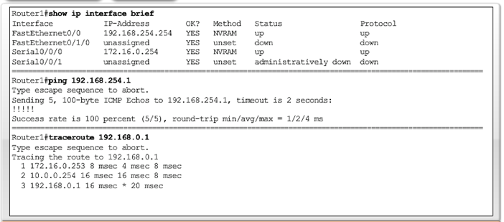
Host and IOS Commands Using show ip interface brief Command
Can be used to verify the status of all network interfaces on a router or a switch.
Notes:
11.3.4.4 Using the show ip interface brief Command

Slide 42
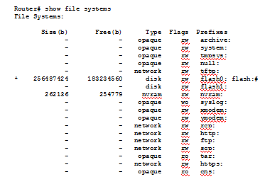
Router and Switch File Systems Router File Systems
show file systems command - lists all of the available file systems on a Cisco 1941 route
* Asterisk indicates this is the current default file system
Notes:
11.4 Managing IOS Configuration Files
11.4.1 Router and Switch File Systems
11.4.1.1 Router File Systems

Slide 43
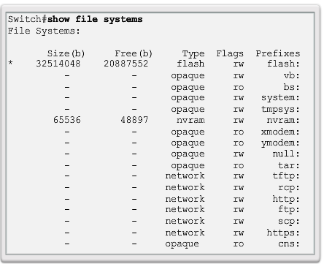
Router and Switch File Systems Switch File Systems
show file systems command - lists all of the available file systems on a Catalyst 2960 switch.
Notes:
11.4.1.2 Switch File Systems

Slide 44
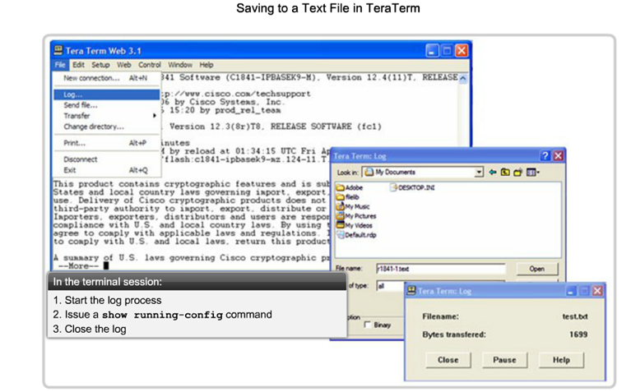
Backup and Restore Configuration Files Backup and Restore using Text Files
Notes:
11.4.2 Backup and Restore Configuration Files
11.4.2.1 Backing up and Restore using Text Files

Slide 45
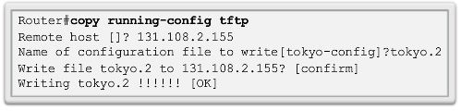
Backup and Restore Configuration Files Backup and Restore using TFTP
Configuration files can be stored on a Trivial File Transfer Protocol (TFTP) server.
copy running-config tftp – save running configuration to a tftp server
copy startup-config tftp - save startup configuration to a tftp server
Notes:
11.4.2 Backup and Restore Configuration Files
11.4.2.2 Backing up and Restore using TFTP

Slide 46
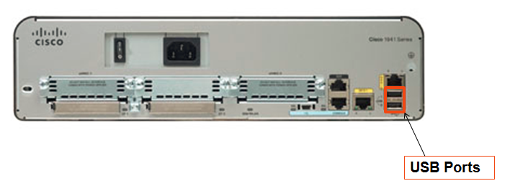
Backup and Restore Configuration Files Using USB Interfaces on a Cisco Router
USB flash drive must be formatted in a FAT16 format.
Can hold multiple copies of the Cisco IOS and multiple router configurations.
Allows administrator to easily move configurations from router to router.
Notes:
11.4.2.3 Using USB Interfaces on a Cisco Router

Slide 47
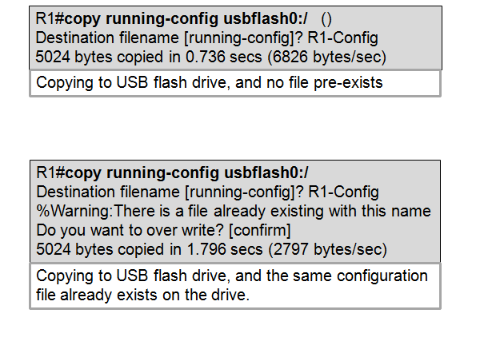
Backup and Restore Configuration Files Backup and Restore Using USB
Notes:
11.4.2.4 Backup and Restore Using USB

Slide 48
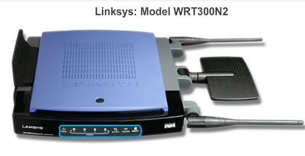
Integrated Router Multi-function Device
Incorporates a switch, router, and wireless access point.
Provides routing, switching and wireless connectivity.
Linksys wireless routers, are simple in design and used in home networks
Cisco Integrated Services Router (ISR) product family offers a wide range of products, designed for small office to larger networks.
Notes:
11.5 Integrated Routing Services
11.5.1 Integrated Router
11.5.1.1 Multi-function device
11.5.1.2 Types of Integrated Routers

Slide 49
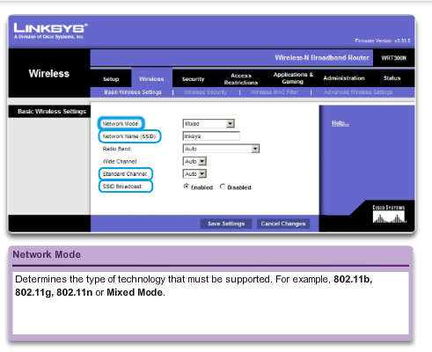
Integrated Router Wireless Capability
Wireless Mode -Most integrated wireless routers support 802.11b, 802.11g and 802.11n
Service Set Identifier (SSID) - Case-sensitive, alpha-numeric name for your home wireless network.
Wireless Channel – RF spectrum divided up into channels.
Notes:
11.5.1.3 Wireless Capability

Slide 50
Integrated Router Basic Security of Wireless
Change default values
Disable SSID broadcasting
Configure Encryption using WEP or WPA
Wired Equivalency Protocol (WEP) - uses pre-configured keys to encrypt and decrypt data. Every wireless device allowed to access the network must have the same WEP key entered.
Wi-Fi Protected Access (WPA) – also uses encryption keys from 64 bits up to 256 bits. New keys are generated each time a connection is established with the AP. Therefore more secure.
Notes:
11.5.1.4 Basic Security of Wireless

Slide 51
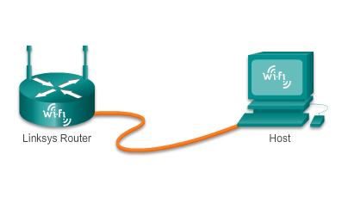
Integrated Router Configuring the Integrated Router
Access the router by cabling a computer to one of the router’s LAN Ethernet ports.
The connecting device will automatically obtain IP addressing information from Integrated Router
Change default username and password and the default Linksys IP address for security purposes.
Notes:
11.5.2 Configuring the Integrated Router
11.5.2.1

Slide 52
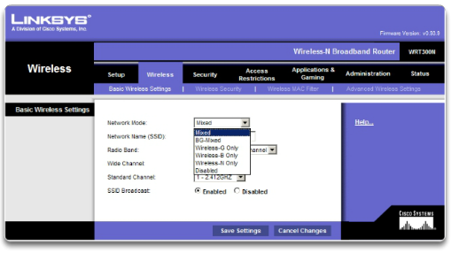
Integrated Router Enabling Wireless
Configure the wireless mode
Configure the SSID
Configure RF channel
Configure any desired security encryption
Notes:
11.5.2.2 Enabling Wireless

Slide 53
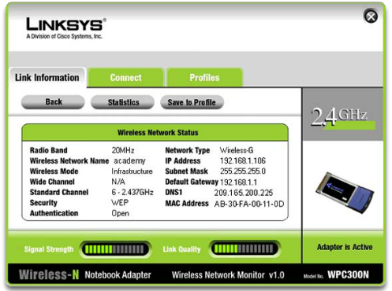
Integrated Router Configure a Wireless Client
The wireless client configuration settings must match that of the wireless router.
SSID
Security Settings
Channel
Wireless client software can be integrated into the device operating system or stand alone, downloadable, wireless utility software.
Notes:
11.5.2.3 Configure a Wireless Client

Slide 54
Chapter 11: Summary
Good network design incorporates reliability, scalability, and availability.
Networks must be secured from viruses, Trojan horses, worms and network attacks.
Document Basic Network Performance.
Test network connectivity using ping and traceroute.
Use IOS commands to monitor and view information about the network and network devices.
Backup configuration files using TFTP or USB.
Home networks and small business often use integrated routers, which provide the functions of a switch, router and wireless access point.
Notes:
11.6 Summary

Slide 55


